Slide 1


Slide 2
CLOSED CIRCUIT COOLER
Product and Application Overview

Slide 3
Closed Circuit Coolers
Principle of operation
Hot Saturated Discharge Air
The cooling fluid is circulated through a multi-pass heat transfer coil.
Recirculated cooling water is sprayed over the coil opposite airflow.
Heat is rejected to the environment by evaporating a portion of the recirculated cooling water.
Hot Water
In
Cool Dry
Entering Air
Notes:
The process or cooling fluid is circulated through the coil of the closed circuit cooler. Heat from the process fluid is dissipated through the coil tubes to the water cascading downward over the tubes. Simultaneously, air is drawn in through the air inlet louvers at the base of the cooler and travels upward over the coil opposite the water flow.
A small portion of the water is evaporated which removes the heat. The warm moist air is drawn to the top of the closed circuit cooler by the fan and is discharged to the atmosphere. The remaining water falls to the sump at the bottom of the cooler where it is recirculated by the pump up to the water distribution system and back down over the coil or coils.

Slide 4
Closed Circuit Coolers
Principle of operation
Hot Saturated Discharge Air
The cooling fluid through a coil
Spray water over the coil
Air flow counter to spray water
Heat rejected through coil wall to spray water
Heat is rejected by
evaporation-indirectly
HEAT
Hot Water
In
HEAT
HEAT
Cool Dry
Entering Air
EVAPORATES!
Notes:
This is a diagram of the heat removal process of a closed circuit cooler. This is an in-direct cooling process, and has many more benefits to the owner which we will discuss.

Slide 5
Closed Circuit Coolers
Application advantages:
Closed System:
- Will not foul heat exchanger surfaces
- Will not contaminate process cooling equipment
- Reduced maintenance costs

Slide 6
Closed Circuit Coolers
Application advantages (cont.)
Higher Fluid Temperature Limitations
- Less likely to damage components
- Maximum fluid temperature of 75°C
Dry Operation Option (except ESWA)
- Utilize bare coil
- Utilize coils with extended surface (spiral fins)

Slide 7
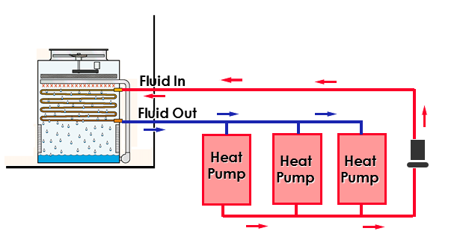
Example Applications: Heat Pump – Shopping Centres

Slide 8
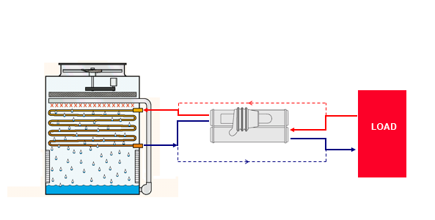
Example Applications: Chillers – Critical Cooling Loads

Slide 9
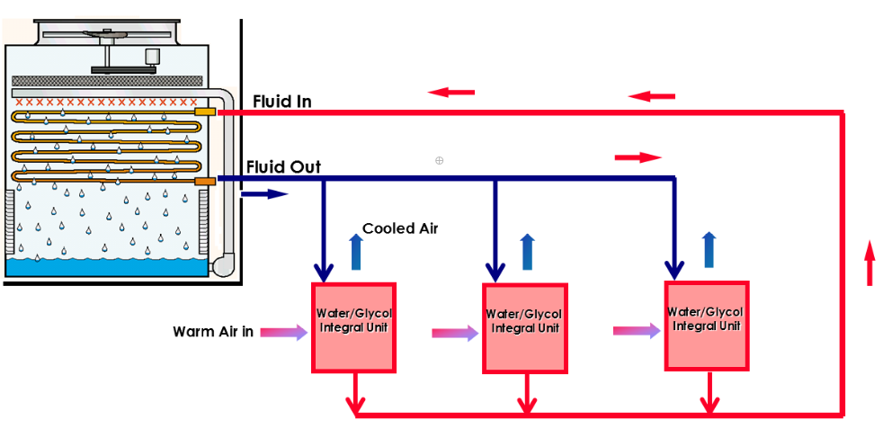
Example Applications: Computer Room AC

Slide 10
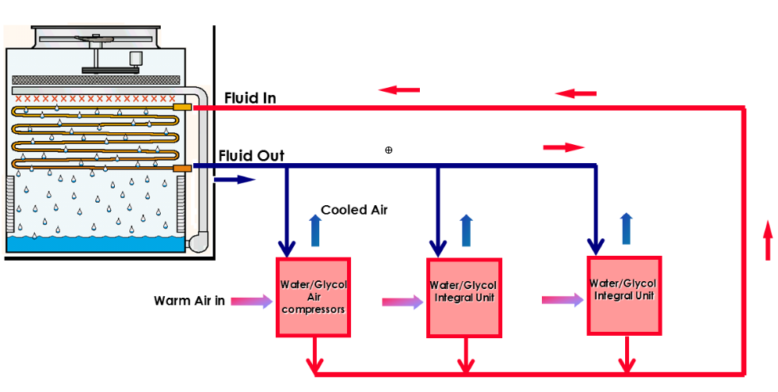
Example Applications: Computer Room AC

Slide 11
Closed Circuit Coolers
Types of factory assembled closed circuit coolers:
Induced Draft Counterflow - ATW and ESWA/B
Forced Draft Counterflow - LSWA and LRW

Slide 12
ATW
Induced Draft
Closed Circuit Coolers

Slide 13
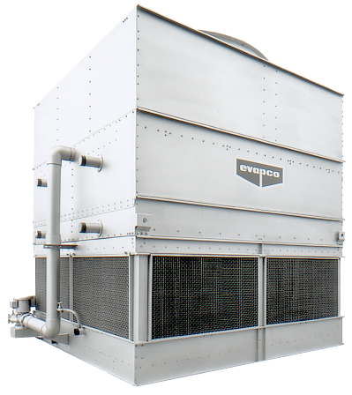
ATW Closed Circuit Coolers
ATW Models
Power-Band Drive
Axial Fan

Slide 14
ATW-Advanced Materials Of Construction
Standard Materials
Z-725 Hot-Dip Galvanized Steel
PVC Spray Distribution System
PVC Inlet Louvers
PVC Drift Eliminators
Stainless Steel Strainers

Slide 15
ATW-Advanced Materials Of Construction
Optional
Type 304 or 316, Stainless Steel Cold Water Basins Available on All Induced Draft Products
Stainless Steel

Slide 16
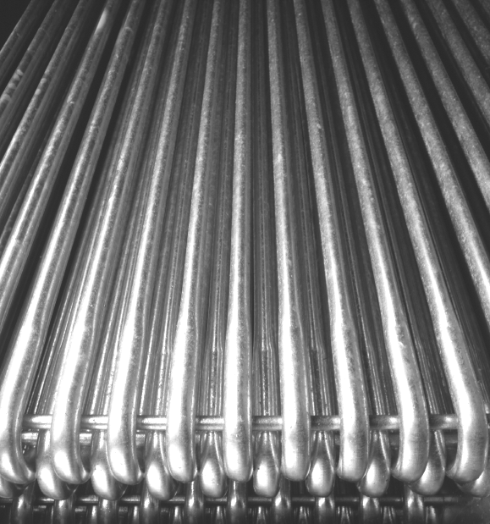
Exclusive Thermal-pak® Coil
Patent Granted
1988
No. 5,799,725

Slide 17
Exclusive Thermal-pak® Coil
Thermal-Pak Coil Benefits
Lowers Air Pressure Drop
Increased Spray Water Flow
Maximize Tube Surface Area
Enhanced dry performance
Notes:
EVAPCO’s Thermal-Pak coils feature an elliptical design which assures maximum cooling capacity. This design provides a more aerodynamic shape, which lowers air side pressure drop while allowing more water to be loaded on the coil.

Slide 18
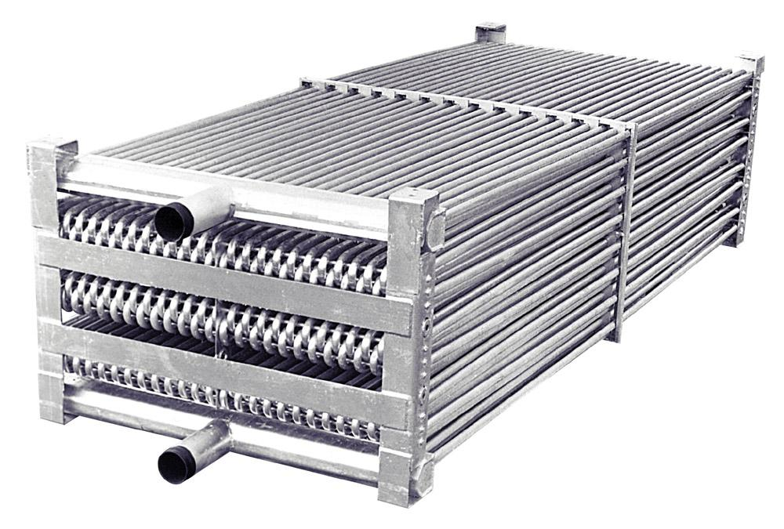
Exclusive Thermal-pak® Coil
Coil Types
Galvanized (standard)
304/316 Stainless Steel Coil

Slide 19
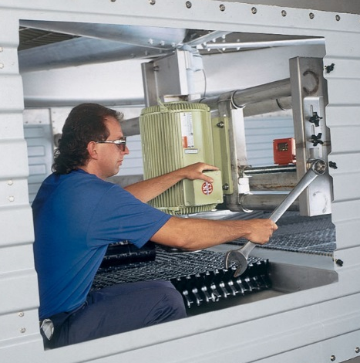
ATW Simplified Maintenance
The Most Accessible Mechanical Equipment and Spray Distribution System in the Industry
THERMAL-PAK® COIL Acts As Working Platform
Provides “Safe” Work Area to Perform Maintenance on Mechanical Equipment and Spray Distribution System

Slide 20
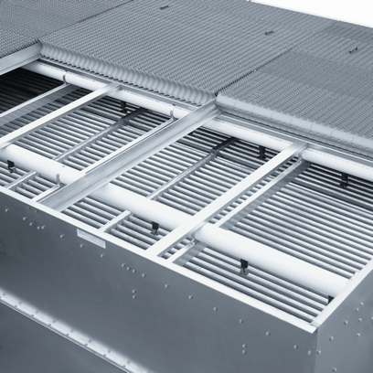
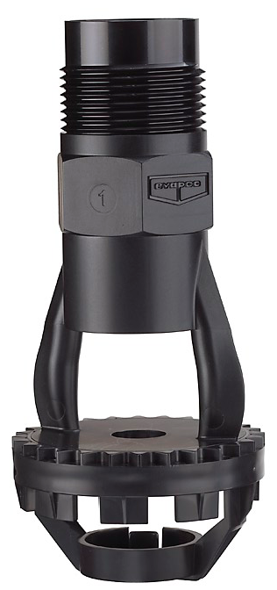
Water Distribution
PVC Spray Header & Nozzles
Threaded Nozzles
Eliminate “Rubber Grommets”

Slide 21
ZM II Nozzles
Fixed Position Nozzle
ABS material
Anti-Sludge Ring
Up to 75% less Nozzles
No Moving Parts!
Notes:
Acrylonitril-butadieen-styreen (ABS)

Slide 22
ATW Design Features
Independent IBC Certification
Notes:
The ESW features the very best of Evapco’s innovative and proven technologies…And has redefined the meaning of performance through a new “Optimized” technology…
In developing the ESW, Evapco’s research team threw out preconceived notions of how a fluid cooler was supposed work…and they revisited the raw elements of heat transfer with consideration for how they apply to their proven technologies. [Click]

Slide 23
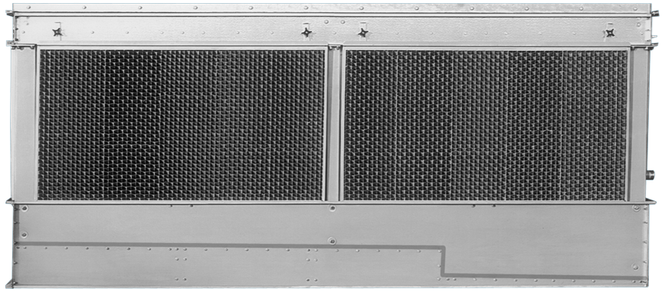
ATW Simplified Maintenance
Clean Pan Sloped Basin Design

Slide 24
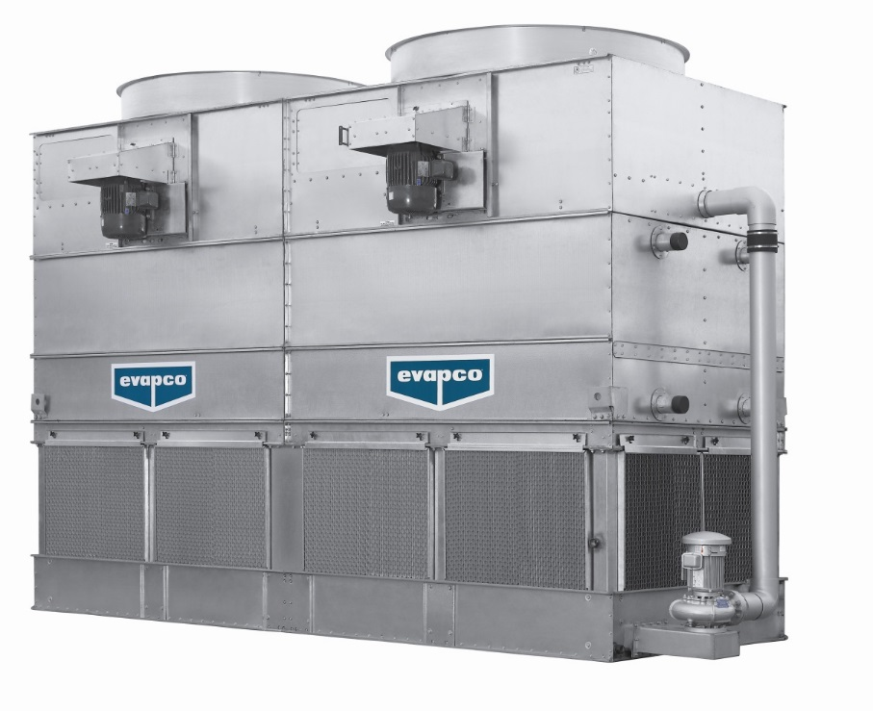
New Containerized C-ATWB

Slide 25
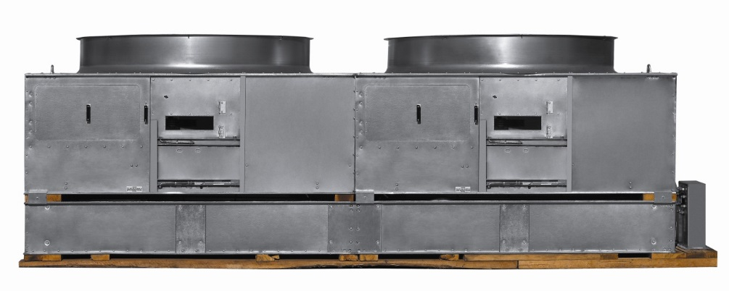
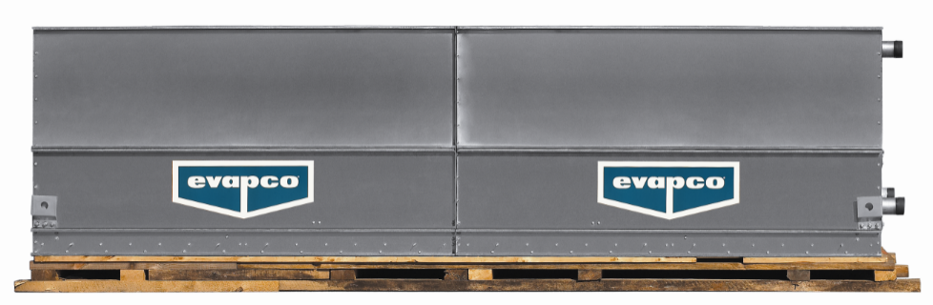
New Containerized C-ATWB
Ships in Two Sections
Fan Section and Basin
Coil and Casing

Slide 26
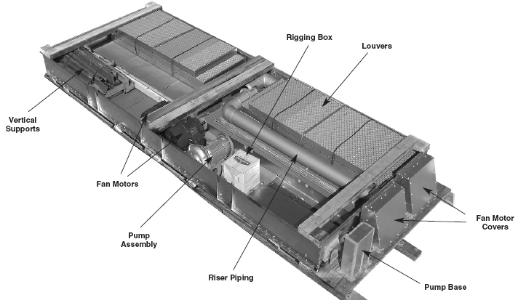
New Containerized C-ATWB
All Parts Ship in the Basin!

Slide 27
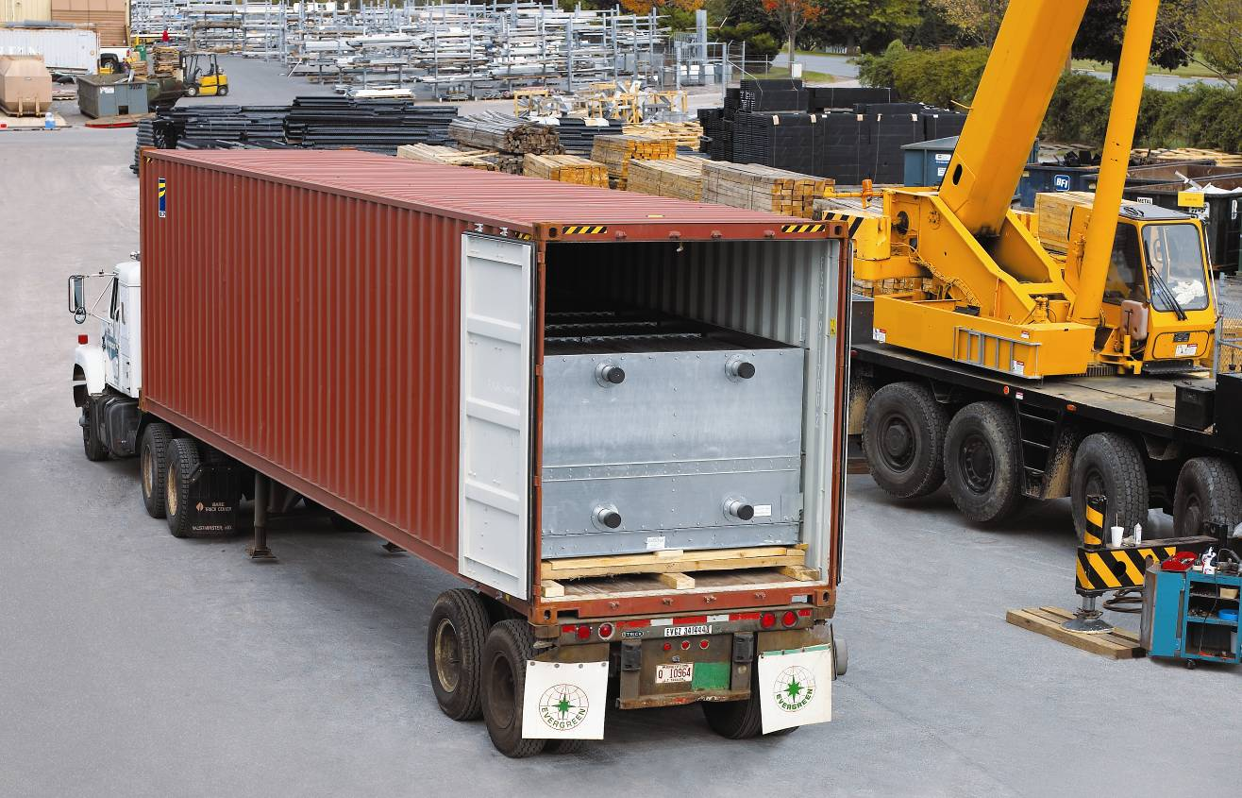
New Containerized C-ATWB
Sections fit into a Shipping Container

Slide 28
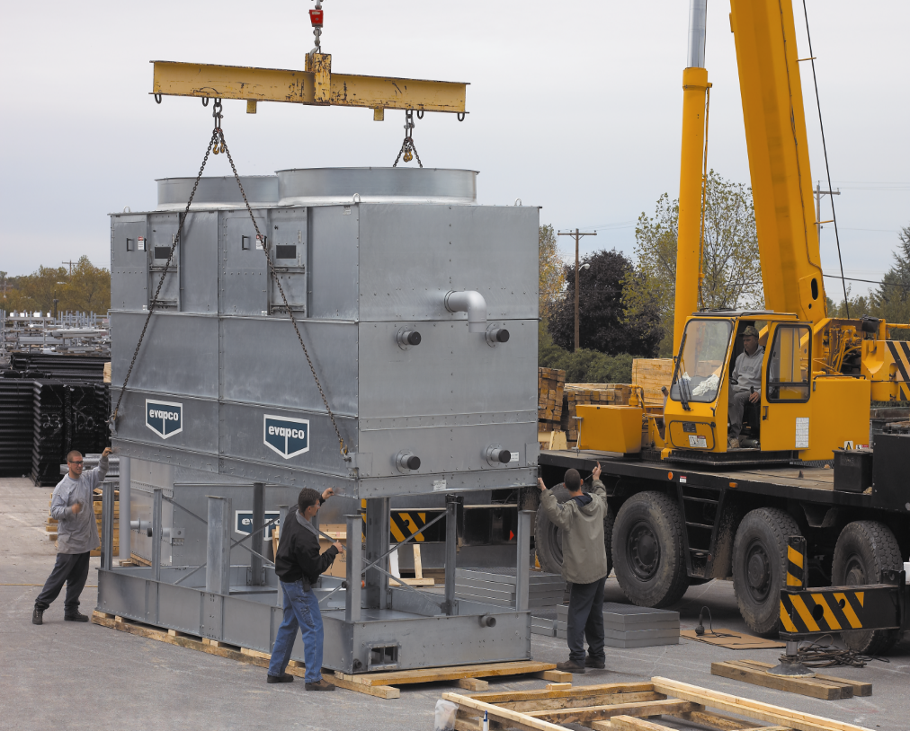
New Containerized C-ATWB
Vertical Supports are Added and Unit is Assembled

Slide 29
ESWA
Energy Efficient
Low Sound Closed Circuit Cooler
Notes:
Hello, my name is _________. Today’s presentation is about the new ESW closed circuit cooler from Evapco…The ESW is an energy efficient, low sound closed circuit cooler featuring the very latest in evaporative cooling technology.
If you have any questions during the presentation, please feel free to stop me at any time. [Click]

Slide 30
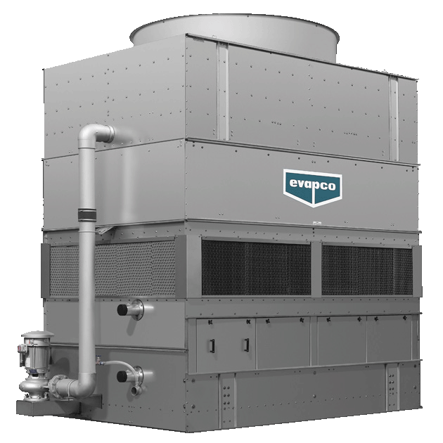
ESWA Closed Circuit Coolers
ESWA Models
Contains both Fill and Coil
184 Models
5 Box Sizes

Slide 31
ESWA Patented Optimized Technology
Optimized transfer of Latent heat → Counterflow Fill
+
Optimized transfer of Sensible heat → Flooded Coil
The most efficient closed circuit cooler ever!
Notes:
The combination of latent heat transfer through the counterflow fill and sensible heat transfer over the surface of the coil is what makes the ESW patented optimized technology the most efficient in the industry. [Click]

Slide 32
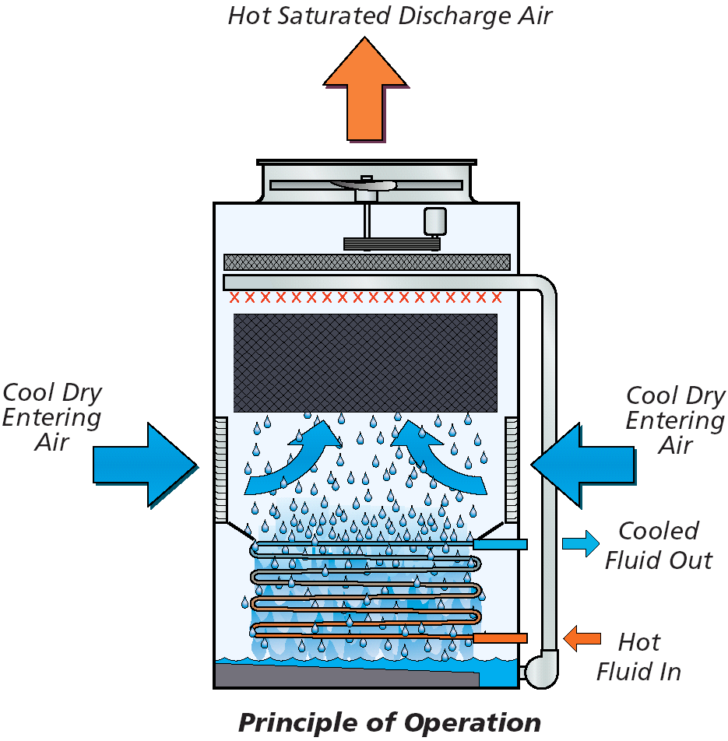
ESWA Principle of Operation
Notes:
And here is a visual representation of how it works. (Animate!!)
The warm process fluid circulates from the heat source to the coil of the closed circuit cooler. The fluid in the coil transfers its heat through the tube walls to the spray water by sensible heat transfer.
Having gained heat from the coil, the spray water then falls at the rate of 12 gpm/ft2 of coil to the sump where it is circulated by the spray pump up to the spray nozzles. The warmed spray water is then distributed as a thin film over the fill surface at a rater of 6 gpm/ft2 of fill for maximum cooling efficiency.
The fan system operates simultaneously, moving large volumes of air through the unit opposite the falling water. The air and water contact across the fill surface causing a small portion of the spray water to be evaporated.
The evaporation process is a latent transfer of heat from the spray water to the air passing through the unit. The warm and saturated air is then discharged from the unit with final heat dissipation to the atmosphere. [Click]

Slide 33
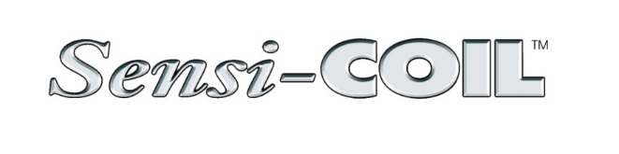
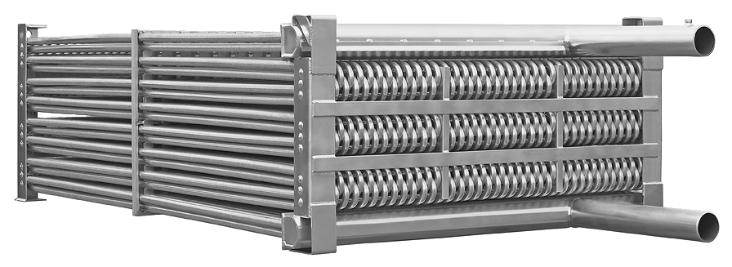
Technology
ESWA Sensi-Coil
Notes:
Introducting the HEART of the New ESWA, Evapco’s new Sensi-Coil Technology. This amazing new technology is the results of months of hard work by the Evapco Product Development and Manufacturing Teams.
[Click]
Sensi-Coil Technology is available exclusively on the ESWA Closed Circuit cooler. [Click]

Slide 34
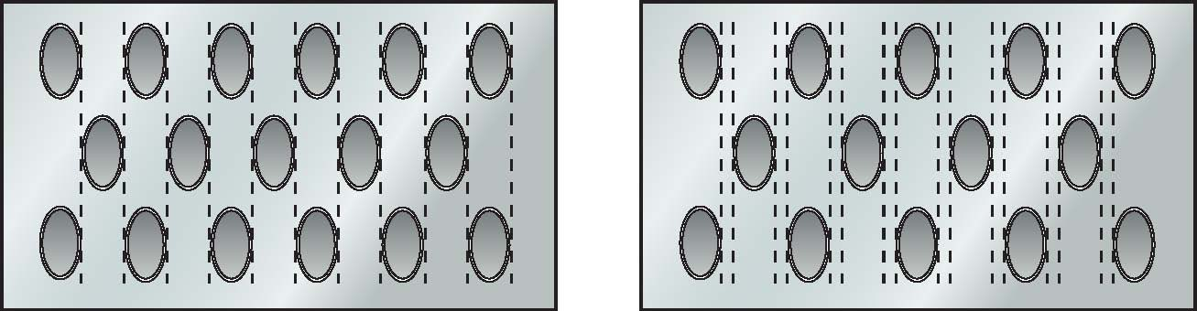
Technology
Reduced Tube Spacing – Perfect for Sensible Cooling
Thermal-Pak® Coil Tube Spacing
Sensi-CoilTM Tube Spacing
Notes:
Sensi-Coil Technology includes reduced tube spacing which is perfect for sensible cooling.
As shown in the diagrams, the Thermal-Pak Coil has extra spacing between the elliptical tubes to allow for airflow between the tube bundles.
The Sensi-Coil has tighter tube spacing, which has been designed specifically for the flooded sensible cooling of the ESWA. Which is the reason that it is only available on this product. [Click]

Slide 35
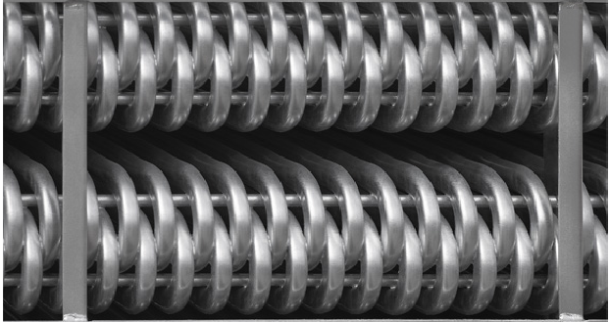
Technology
Reduced Tube Spacing – Perfect for Sensible Cooling
Elliptical Return Bends
More Tubes
21% More Surface Area
in the SAME COIL VOLUME
Leads to Increased Capacity!!
Sensi-CoilTM Elliptical Return Bends
Notes:
With the Sensi-Coil design, Evapco has developed the technology to continue the elliptical shape of the tube all of the way through the tube return bends.
Creating an elliptical return bend in place of the round bends of the Thermal-Pak Coil. [Click]

Slide 36
Major Energy Savings
Low Energy…
30 to 50% less than other Induced draft
80 % less than Forced Draft!
Low Sound…
Better than standard Forced Draft
Notes:
As I had mentioned at the beginning…the ESW provides energy savings and low sound…How Low?...
[Click]
30 to 50% less horsepower than other Induced draft coolers…and up to 80% less than forced draft models.
[Click]
The sound levels of the ESW are as good, or slightly better than standard forced draft coolers…
Let’s go through an example of the potential savings…
[Click]

Slide 37
Decreased Horsepower for the SAME tonnage
Total Fan Energy (HP)
Tons | Evapco Forced Draft | Evapco ATW | Evapco ESWA
100 | 25 | 15 | 7.5
200 | 40 | 25 | 10
300 | 80 | 40 | 15
400 | 80 | 50 | 30
Based on 3 gpm per ton, 95F/85F at 78F wet-bulb.

Slide 38
Decreased HP Compared to Other Brands
Fluid: Water
Flow (gpm): 598.0
Entering Fluid Temp (F): 105.0
Leaving Fluid Temp (F): 90.0
Wetbulb (F): 78.0
Unit Comparison | ESWA 102-46J | BAC FXV 642 | Marley MHF 702D121G-2
Number of fans | 1 | 2 | 4
Total fan HP | 15 | 25 | 30
Total pump HP | 7.5 | 5 | 4
Notes:
If we compare the ESWA selection against the FXV based on standard engineering data, you will see that the ESWA fewer fans, less total horsepower and a smaller footprint than the FXV. [Click]

Slide 39
Decreased Sound Levels from Top and Side
Sound Level –
Measured at 5 ft from the TOP (dBA)
Tons | Evapco Forced Draft | Evapco ATW | Evapco ESWA
200 | 81 | 89 | 77
300 | 85 | 92 | 79
400 | 82 | 89 | 77
500 | 85 | 92 | 79
Based on 3gpm per ton, 95F/85F at 78F wet-bulb.
Notes:
As I had mentioned at the beginning…the ESW provides energy savings and low sound…How Low?...
[Click]
30 to 50% less horsepower than other Induced draft coolers…and up to 80% less than forced draft models.
[Click]
The sound levels of the ESW are as good, or slightly better than standard forced draft coolers…
Let’s go through an example of the potential savings…
[Click]

Slide 40
Decreased Sound Levels from Top and Side
Sound Level –
Measured at 5 ft from the AIR INLET (dBA)
Tons | Evapco Forced Draft | Evapco ATW | Evapco ESWA
200 | 80 | 84 | 73
300 | 87 | 87 | 76
400 | 84 | 84 | 73
500 | 87 | 87 | 76
Based on 3gpm per ton, 95F/85F at 78F wet-bulb.
Notes:
As I had mentioned at the beginning…the ESW provides energy savings and low sound…How Low?...
[Click]
30 to 50% less horsepower than other Induced draft coolers…and up to 80% less than forced draft models.
[Click]
The sound levels of the ESW are as good, or slightly better than standard forced draft coolers…
Let’s go through an example of the potential savings…
[Click]

Slide 41
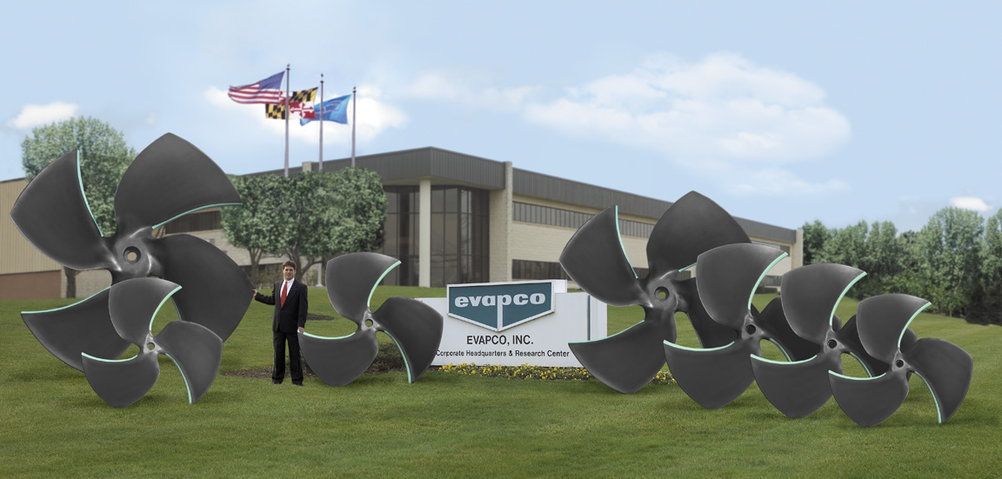
Super Low Sound Fan
Notes:
The ESW features the very best of Evapco’s innovative and proven technologies…And has redefined the meaning of performance through a new “Optimized” technology…
In developing the ESW, Evapco’s research team threw out preconceived notions of how a fluid cooler was supposed work…and they revisited the raw elements of heat transfer with consideration for how they apply to their proven technologies. [Click]

Slide 42

CTI Certification
Notes:
The ESW features the very best of Evapco’s innovative and proven technologies…And has redefined the meaning of performance through a new “Optimized” technology…
In developing the ESW, Evapco’s research team threw out preconceived notions of how a fluid cooler was supposed work…and they revisited the raw elements of heat transfer with consideration for how they apply to their proven technologies. [Click]

Slide 43
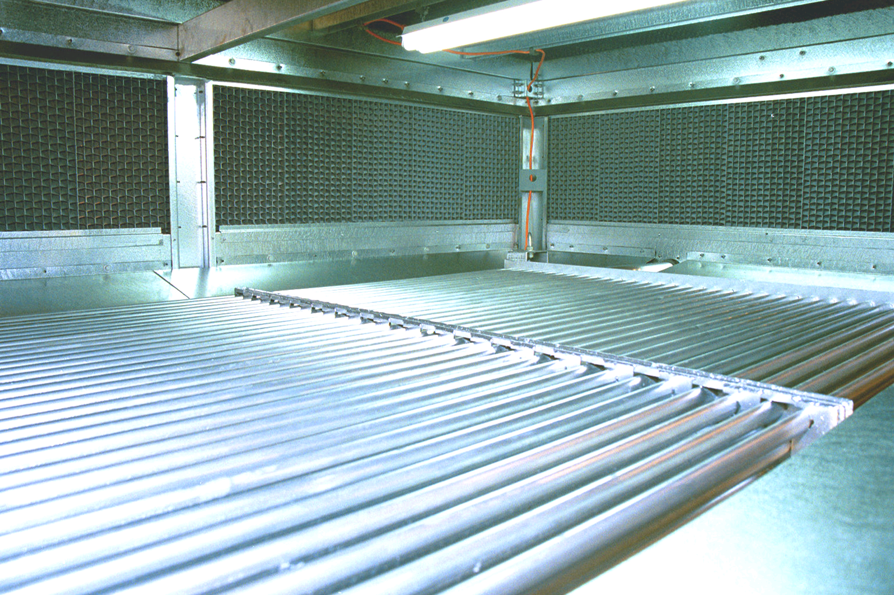
ESWA Features and Benefits
No evaporation on coil – reduced risk for scaling
Notes:
And that is exactly what Evapco did.
They designed a testing program to evaluate the performance of the Thermal-Pak coil with no air over the coil and at very high flow rates per square foot. [Click]

Slide 44
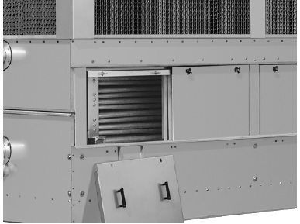
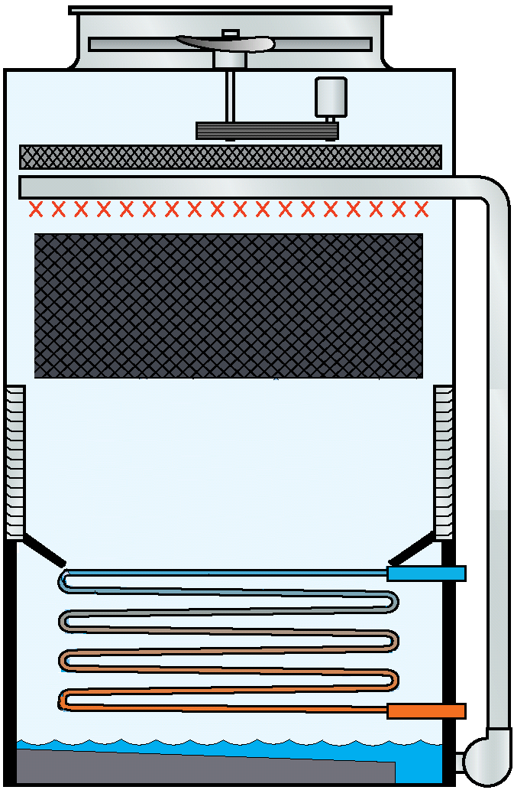
ESWA Features and Benefits
Totally enclosed coil protected from heat loss
Notes:
As I mentioned a few slides back, the ESW is designed with the functionality of a discharge hood as standard. Coil heat loss in the winter is minimized by the protective panels and because freezing air does not have free passage across the coil. The ESW avoids the maintenance expense and hassle associated with lubricating hundreds of pivot pins and linkage to prevent the dampers from seizing. [Click]

Slide 45
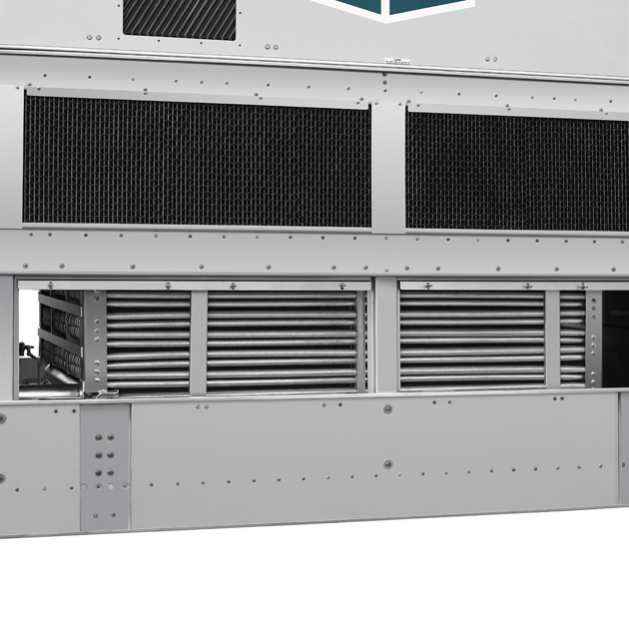
ESWA Features and Benefits
The Most Accessible Coil in the Industry
Easy coil access
Notes:
The ESW features the most accessible coil in the industry. When the protective panels are removed, a service mechanic has complete access to the coil and basin area.
[Click]

Slide 46
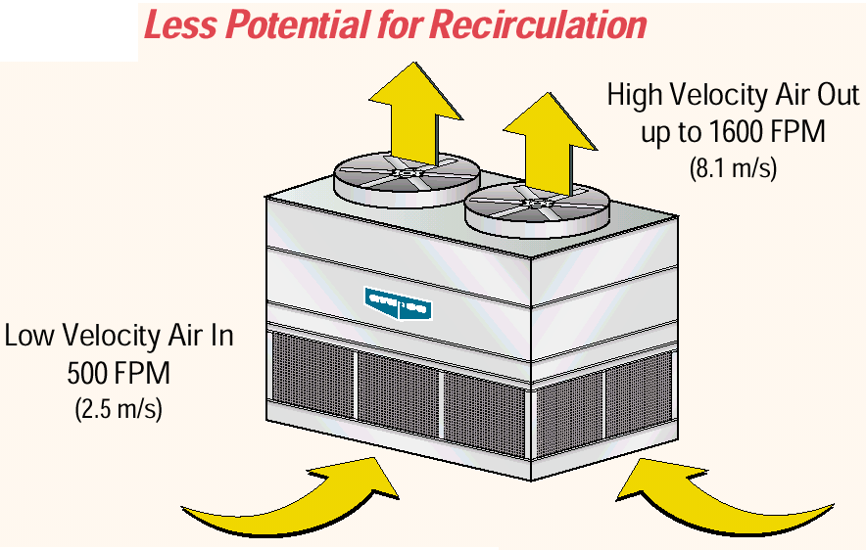
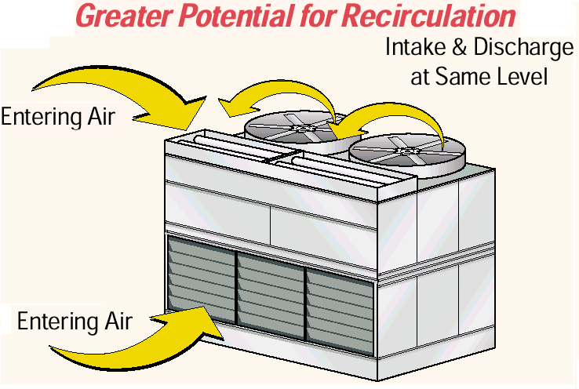
ESWA Features and Benefits
Minimized Recirculation
EVAPCO
Brand-X
Notes:
Minimized recirculation. [Click] please note that the Brand-X design has fresh air intakes immediately adjacent to the warm air discharge. [Click]

Slide 47
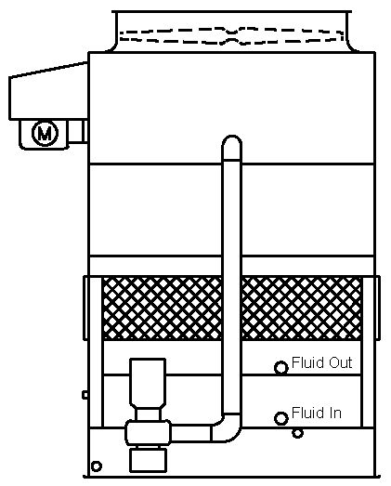
ESWA Features and Benefits
Reverse coil connections
Cooled fluid out
Warm fluid in
Notes:
The ESW is different from our other fluid coolers in that the warm fluid is piped to the lower coil connection and leaves as cooled fluid through the upper coil connection. The coil is piped this way to maintain a counterflow arrangement with respect to the warm fluid in the coil versus the cool spray water from above. [Click]

Slide 48
Closed Circuit Coolers
Types of factory assembled closed circuit coolers
Induced Draft Counterflow - ATW and ESWA/B
Forced Draft Counterflow - LSWA and LRW

Slide 49
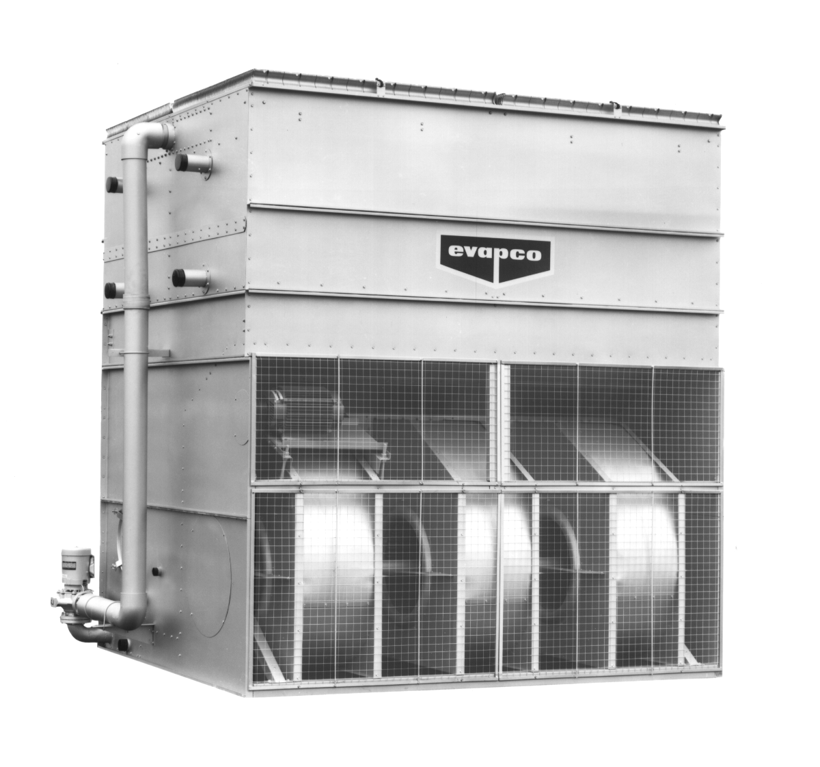
LSWA - Forced Draft Centrifugal
LSWA Models
Centrifugal Fan Design
Capacity: 20 to 945 Tons

Slide 50
LSWB - Forced Draft Centrifugal
Ideal For
Indoor and ducted applications
Very quiet operation
Exact replacement units

Slide 51
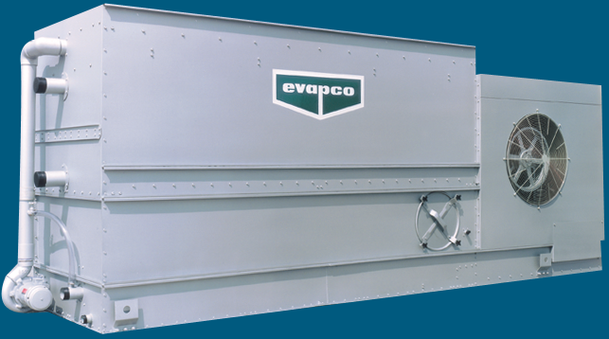
LRW- Low Profile Forced Draft Centrifugal
LRW Models
Centrifugal Fan Design
38 models
Capacity: 15 to 215 Tons

Slide 52
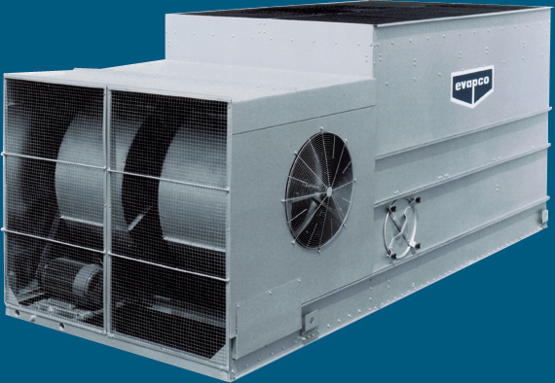
LRW- Low Profile Forced Draft Centrifugal
LRW Features
Integral drive enclosure -First stage of sound attenuation
Standard with a 304 stainless steel basin
Single-section construction allows a one piece lift

Slide 53
THANK YOU
Taking
Quality
and
Service
to a
Higher Level . . .
Notes:
Thank you for your time. Does anyone have any questions.

