Slide 1


Slide 2
Closed Circuit Coolers
Principle of operation
Hot Saturated Discharge Air
The cooling fluid through the coil
Spray water over the coil
Air flow is counter flow to spray water
Heat transferred through the coil wall to spray water
Heat is rejected by evaporation of portion of spray water
Hot Water
In
Cool Dry
Entering Air
Notes:
This is a diagram of the heat removal process of a closed circuit cooler. This is an in-direct cooling process, and has many more benefits to the owner which we will discuss.

Slide 3
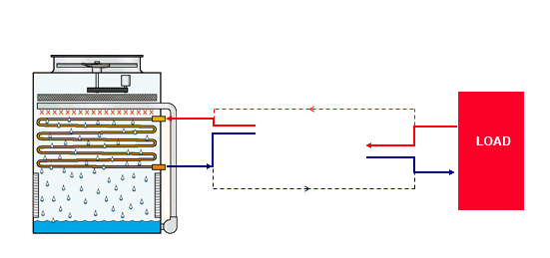

Example Applications: Chillers

Slide 4
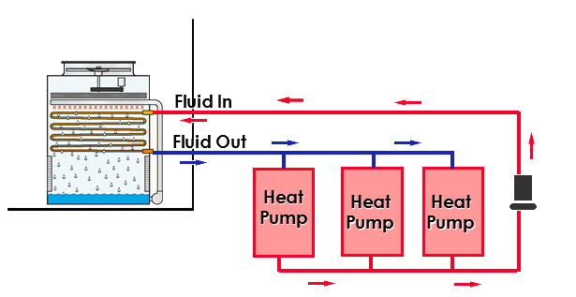
Example Applications: Heat Pumps

Slide 5
Closed Circuit Coolers
Application advantages
Closed System:
Will not foul heat exchanger surfaces
Will not contaminate process cooling equipment
Reduced maintenance costs condenser system and chiller
Higher Fluid Temperature Limitations (Maximum fluid temperature of 75°C)

Slide 6
Closed Circuit Coolers
Application advantages (cont.)
Dry Operation Option (except ESWA & ESWB) :
Reduce water consumption
Avoid potential freezing problems during the winter

Slide 7
Closed Circuit Coolers
Application advantages (cont.)
Dry Operation Option (except ESWA & ESWB) :
Reduce water consumption
Avoid potential freezing problems during the winter
Plume abatement solutions

Slide 8
Induced Draft with Axial Fans
EVAPCO Closed Circuit Coolers Product line

Slide 9
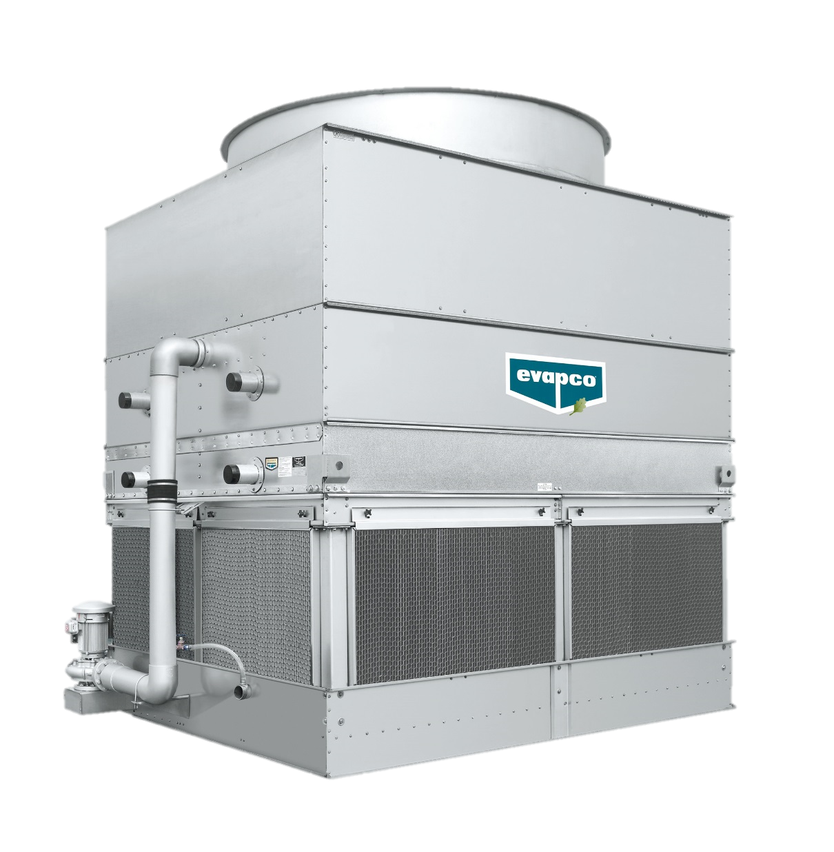
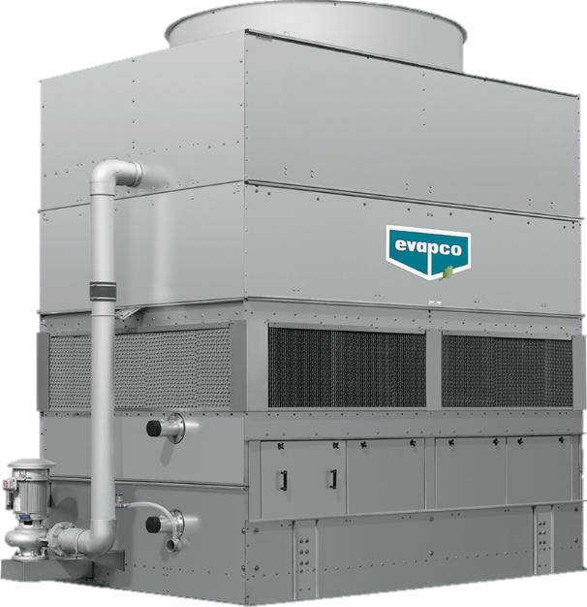
Induced Draft with Axial Fans
ATW
ESWA/B

Slide 10
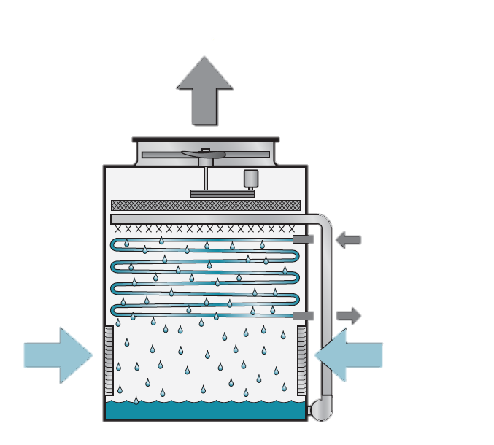
Induced Draft Closed Circuit Coolers with Axial Fan : ATW
Hot Satured Discharge Air
377 models
25 – 6200 kW
1 – 267 l/s
Hot Water In
Cooled Water Out
Cool Dry Entering Air

Slide 11
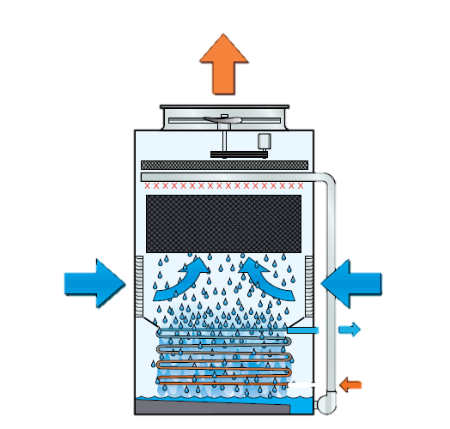
Induced Draft Closed Circuit Coolers with Axial Fan : ESWA
Hot Satured Discharge Air
Combination of coil and fill technology
179 models
264 – 5120 kW
11,4 – 234 l/s
Cool Dry Entering Air
Cool Dry Entering Air
Cooled Fluid Out
Hot Fluid In

Slide 12
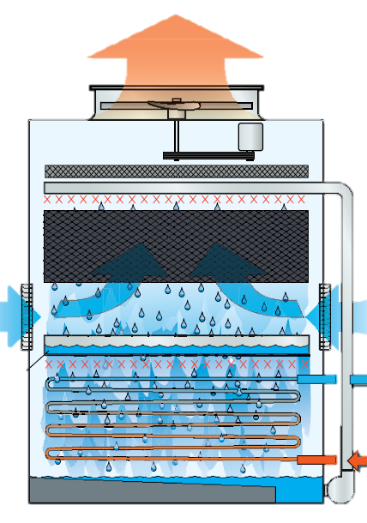
Induced Draft Closed Circuit Coolers with Axial Fan : ESWB
Hot Satured Discharge Air
Combination of coil and fill technology
Maximum capacity per m² footprint
599 models
171 – 2129 KW
7,4 – 92 l/s
Cool Dry Entering Air
Cool Dry Entering Air
Redistribution Basin
Cooled Fluid Out
Hot Fluid In

Slide 13
EVAPCO Closed Circuit Coolers Product line
Forced Draft with Centrifugal Fans

Slide 14
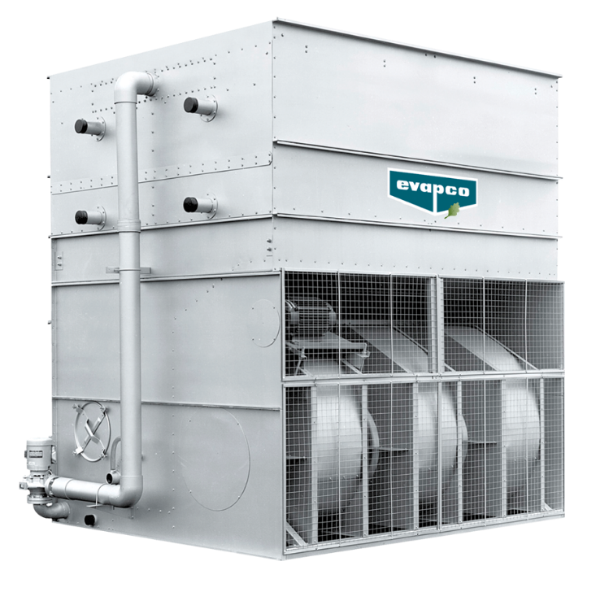
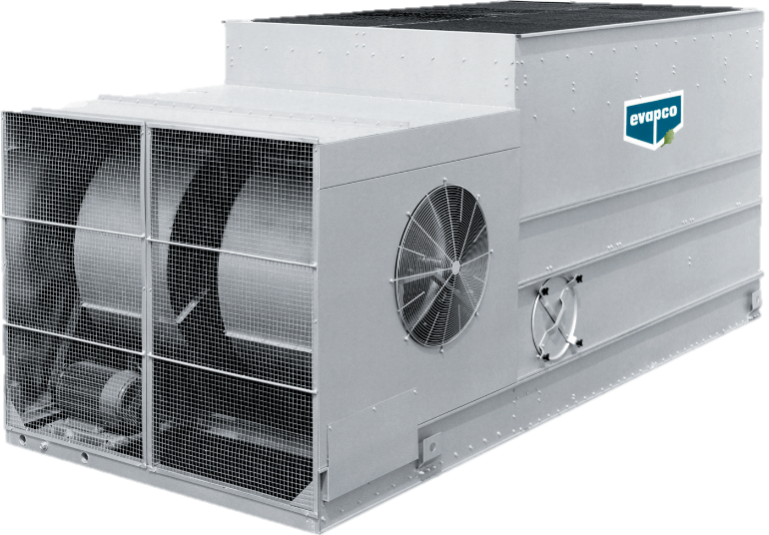
Forced Draft with Centrifugal Fans
LSWA
LRW

Slide 15
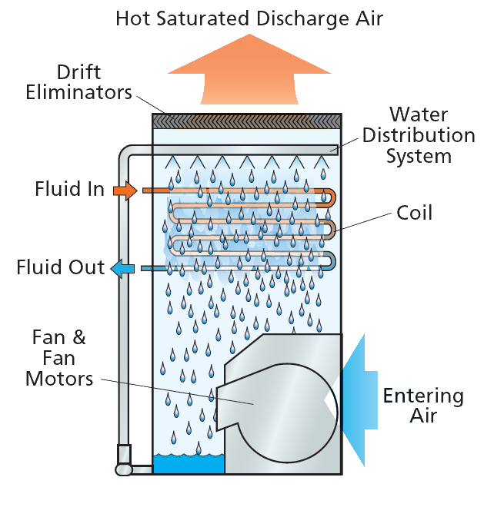
Forced Draft Coolers with Centrifugal Fan : LSWA
50 models
73 – 2673 kW
3,1 – 115 l/s

Slide 16
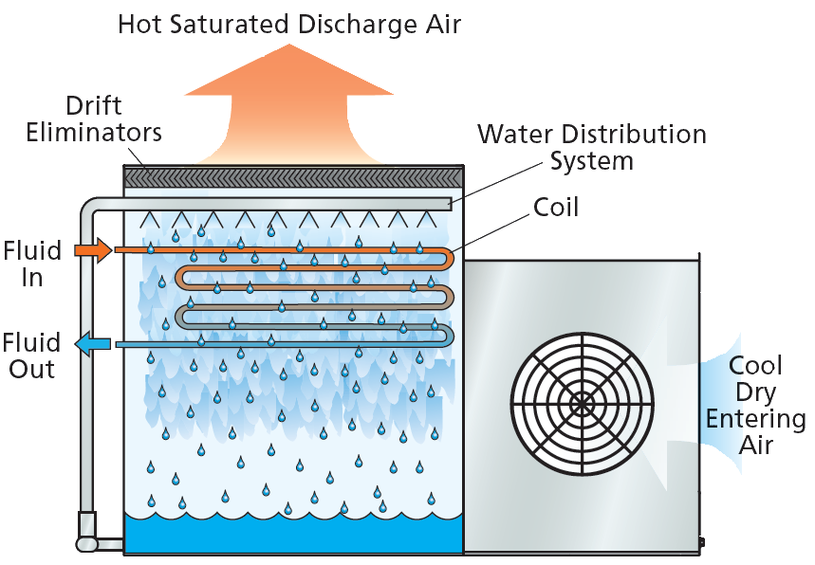
Forced Draft Closed Circuit Coolers with Centrifugal Fan : LRW
Low height applications
38 models
43 – 58 kW
7,7 – 25 l/s

Slide 17
Comparison Different CCC Solutions
Example: 1000 kW (35 - 29,44 - 25,56°C)
Type | Relative cost |  | Fan Motor |  |  | Pump Motor |  |  | Total kW
ATW | 124% |  | 2 | 22 |  | 2 | 2,2 |  | 48,4
 | 130% |  | 2 | 15 |  | 2 | 2,2 |  | 34,4
ESWA | 100% |  | 1 | 15 |  | 1 | 7,5 |  | 22,5
ESWB | 120% |  | 1 | 18,5 |  | 1 | 7,5 |  | 26
LSWA | 125% |  | 1 | 37 |  | 1 | 5,5 |  | 42,5

Slide 18
Comparison Different CCC Solutions
Example: 1000 kW (35 - 29,44 - 25,56°C)
Type | Relative cost |  | Fan Motor |  |  | Pump Motor |  |  | Total kW
ATW | 124% |  | 2 | 22 |  | 2 | 2,2 |  | 48,4
 | 130% |  | 2 | 15 |  | 2 | 2,2 |  | 34,4
ESWA | 100% |  | 1 | 15 |  | 1 | 7,5 |  | 22,5
ESWB | 120% |  | 1 | 18,5 |  | 1 | 7,5 |  | 26
LSWA | 125% |  | 1 | 37 |  | 1 | 5,5 |  | 42,5

Slide 19
EVAPCO Closed Circuit
HYBRID Coolers Product line

Slide 20
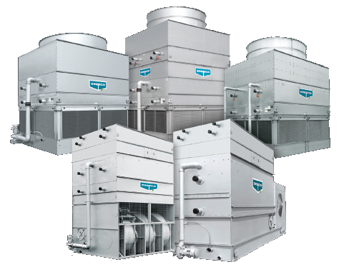
Notes:
In this slide, we can see all the hybrid units together. Units which have been developed to increase the dry performance to save water and when possible to save energy. Save water means not only propose an evaporative unit which let the customer to reduce the water itself, but also a unit which take the customer to spend less money for all the costs connected to the consuption of water: chemical cost, sewer cost etc
--
You know we can offer centrifugal and axial units, so EVAPCO is able to supply all the possible solutions for all the project where an evaporative unit is required to save water and energy (when it is possible)

Slide 21
Dry operation - Save water Plume abatement
EVAPCO Closed Circuit
HYBRID Coolers Product line

Slide 22
Induced Draft with Axial Fans
EVAPCO Closed Circuit
HYBRID Coolers Product line

Slide 23
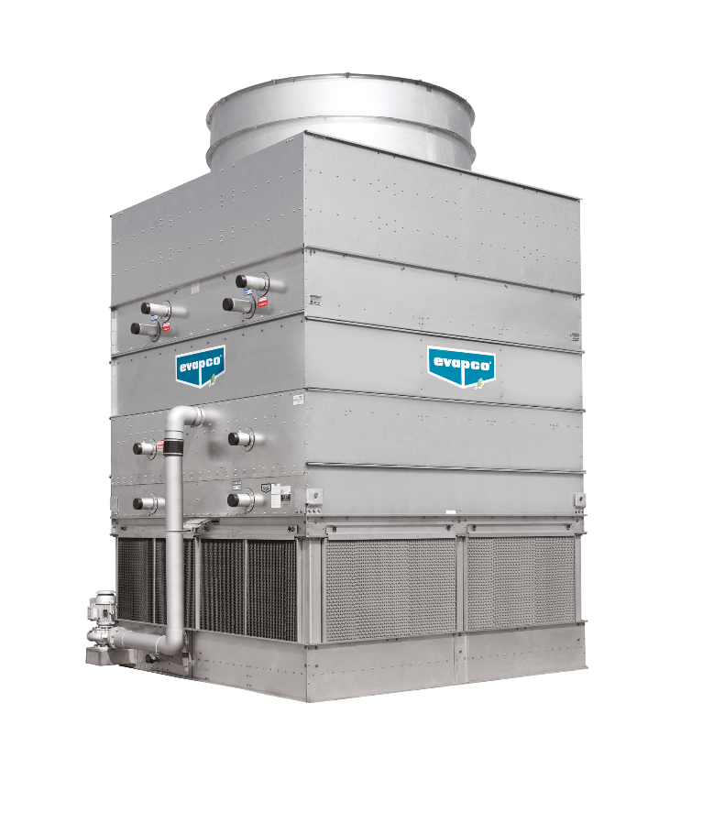

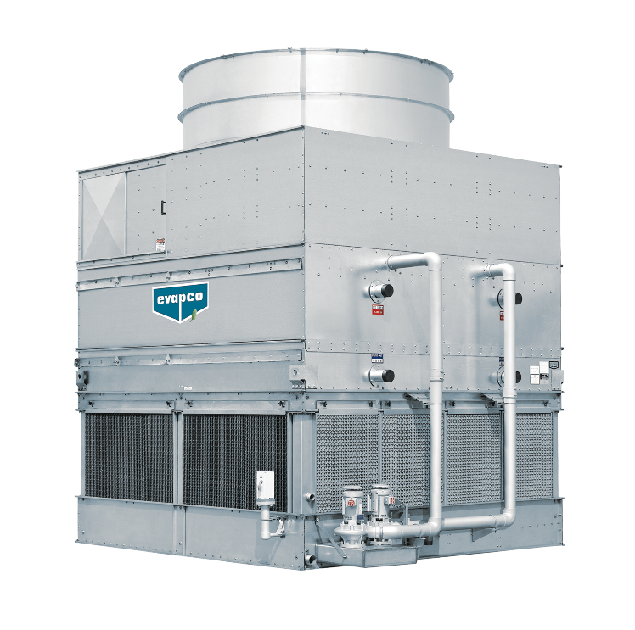
Induced Draft with Axial Fans
eco-ATWB
eco-ATWB-H
eco-ATWB-E

Slide 24
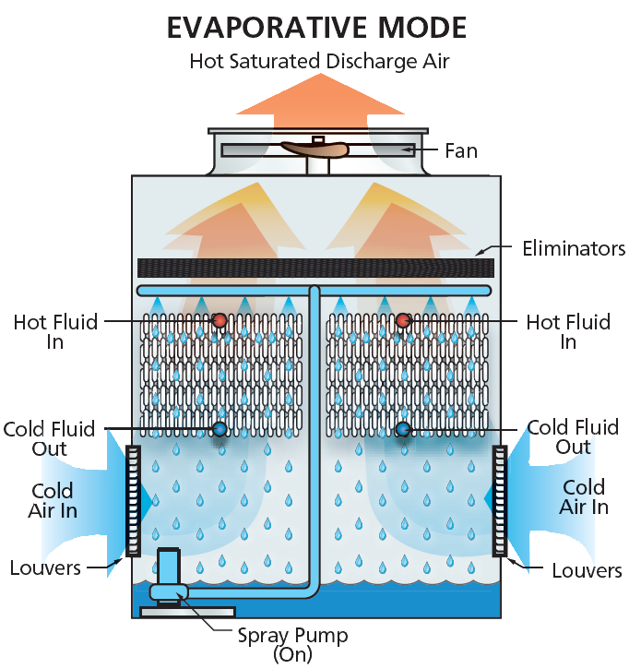
Hybrid Closed Circuit Coolers with Axial Fans: eco-ATWB
CROSSCOOLTM
Ellipti-fin®:Extended surface coil
Excellent dry switch points

Slide 25
Hybrid Closed Circuit Coolers with Axial Fans: eco-ATWB
704 models
42 – 10810 kW
1,8 – 466 l/s

Slide 26
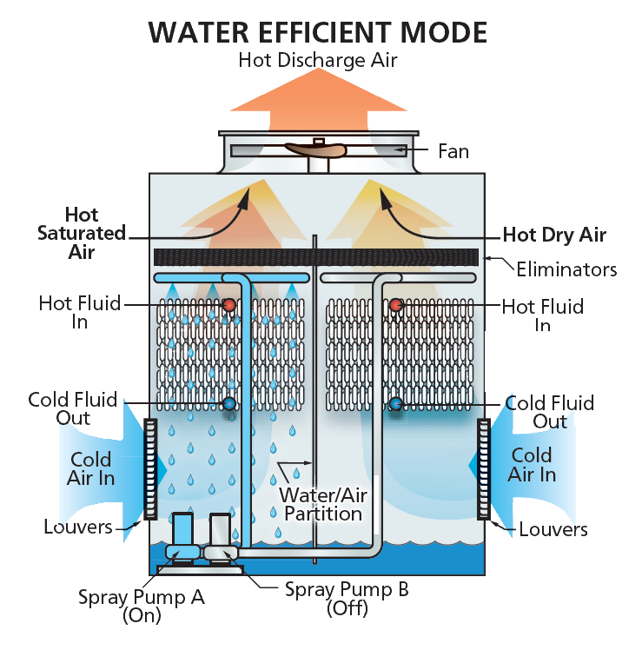
Hybrid Closed Circuit Coolers with Axial Fans: eco-ATWB-E
CROSSCOOLTM
Ellipti-fin®: Extended surface coil
Hybrid operation possible
Reduced Water Consumption

Slide 27
Hybrid Closed Circuit Coolers with Axial Fans: eco-ATWB-E
228 models
377 – 2630 kW
16,3 – 113 l/s

Slide 28
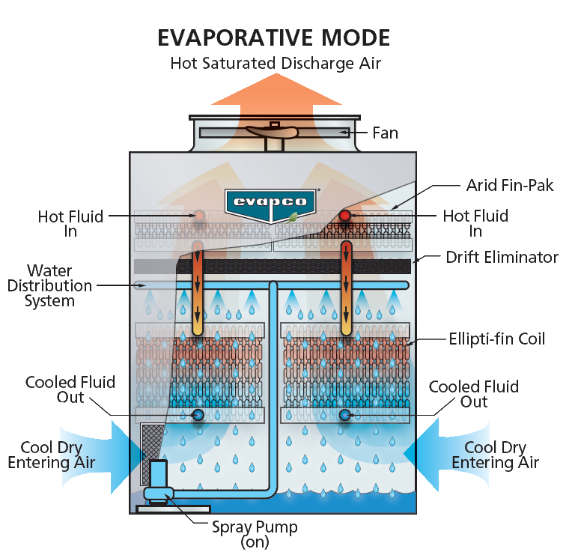
Hybrid Closed Circuit Coolers with Axial Fans: eco-ATWB-H
CROSSCOOLTM
Ellipti-fin®
ARID-fin PakTM: Dry cooling coil
Hybrid operation
Maximum dry switch points
Optimized technology for increased water savings
Plume abatement

Slide 29
Hybrid Closed Circuit Coolers with Axial Fans: eco-ATWB-H
2036 models
250 – 4895 kW
10,8 – 211 l/s

Slide 30
Forced Draft with Centrifugal Fans
EVAPCO Closed Circuit
HYBRID Coolers Product line

Slide 31
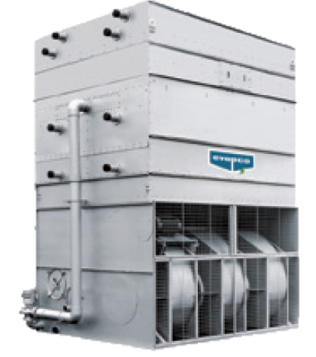
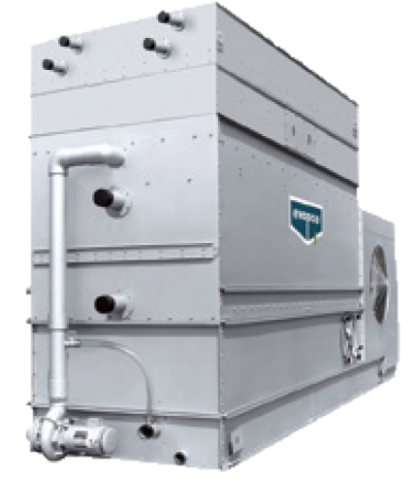
Hybrid Forced Draft with Centrifugal Fans
LSWA-H
LRW-H

Slide 32
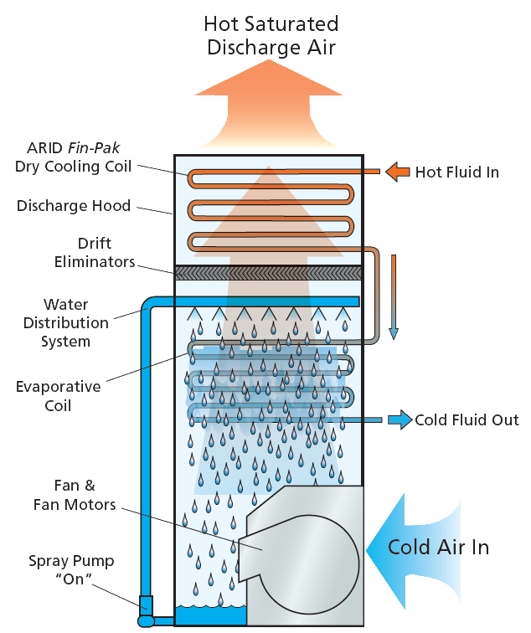
Hybrid Closed Circuit Coolers with Centrifugal Fans: LSWA-H
ARID-fin PakTM: Dry cooling coil
High dry switch points
Hybrid operation
Reduced water consumption
Plume abatement

Slide 33
Hybrid Closed Circuit Coolers with Centrifugal Fans: LSWA-H
ARID-fin PakTM: Dry cooling coil
215 models
73 – 2673 kW
3,1 – 115 l/s

Slide 34
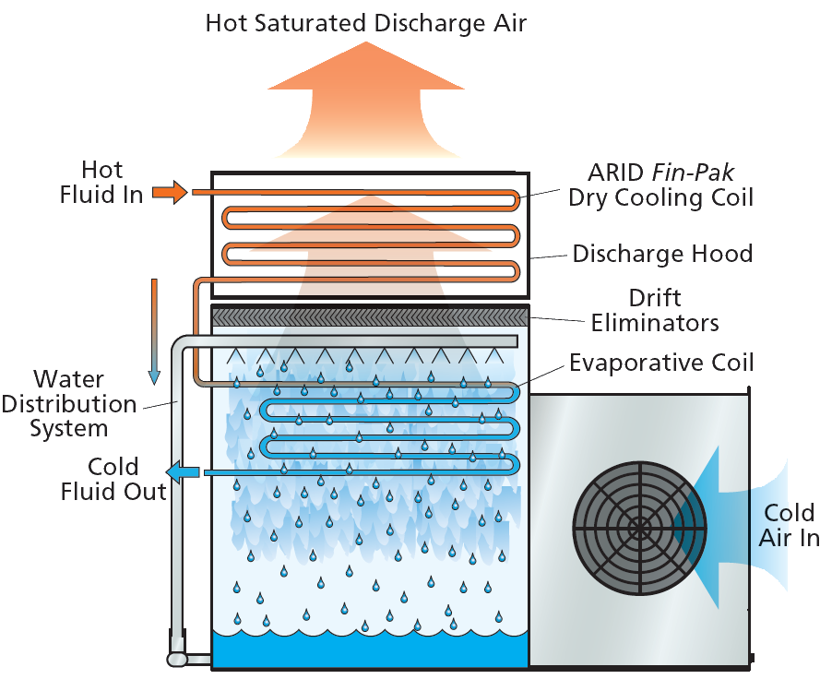
Hybrid Closed Circuit Coolers with Centrifugal Fans: LRW-H
ARID-fin PakTM: Dry cooling coil
High dry switch points
Hybrid operation
Reduced water consumption
Plume abatement

Slide 35
Hybrid Closed Circuit Coolers with Centrifugal Fans: LRW-H
ARID-fin PakTM: Dry cooling coil
91 models
43 – 580 kW
1,9 – 25 l/s

Slide 36
Comparison Different Hybrid Models
Example: 1000 kW (35 - 29,44 - 25,56°C)
Type | Relative cost |  | Fan Motor |  |  | Pump motor |  |  | Total kW
eco ATWB | 100% |  | 1 | 30 |  | 1 | 5,5 |  | 35,5
 | 112% |  | 1 | 18,5 |  | 1 | 5,5 |  | 24
eco ATWB E | 170% |  | 1 | 30 |  | 2 | 2,2 |  | 34,4
 | 173% |  | 1 | 15 |  | 2 | 2,2 |  | 19,4
eco ATWB H | 191% |  | 1 | 15 |  | 1 | 5,5 |  | 20,5
LSWA - H | 149% |  | 2 | 37,5 |  | 1 | 5,5 |  | 80,5

Slide 37
Hybrid Solutions – Comparison Dry Operation
Example: 1000 kW (35 - 29,44 - 25,56°C)
Type | Relative cost |  | Fan Motor |  |  | Pump motor |  |  | Total kW |  | Dry Switch Point
eco ATWB | 100% |  | 1 | 30 |  | 1 | 5,5 |  | 35,5 |  | +4,1°C
 | 112% |  | 1 | 18,5 |  | 1 | 5,5 |  | 24
eco ATWB E | 170% |  | 1 | 30 |  | 2 | 2,2 |  | 34,4 |  | +4,2°C
 | 173% |  | 1 | 15 |  | 2 | 2,2 |  | 19,4
eco ATWB H | 191% |  | 1 | 15 |  | 1 | 5,5 |  | 20,5 |  | +11,2°C
LSWA - H | 149% |  | 2 | 37,5 |  | 1 | 5,5 |  | 80,5 |  | +11,84°C

Slide 38
Know Your Options
EVAPCO Closed Circuit Coolers

